Slide 1


Data Collection and Cleaning
Instructor: Shri Harini Ramesh
April 28 – May 2, 2025

Slide 2
Goal
Understand types of data
Learn how to design questions that collect useful data

Slide 3
Recap
Data collection is how we gather information to answer a question
Yesterday: We talked about collecting data about yourself (habits, feelings, activities).
Today: Let’s talk about how to collect data from other people too!

Slide 4
Why Collect Data From Others
Everyone’s experience is different
More people = better patterns and stronger results
Example: ➔ If I ask only myself about energy levels, it’s just one view. But if I ask 20 classmates, I can find real trends!

Slide 5
How to Collect?
You can collect data by:
Observing (watch and record)
Asking (talking or interviewing)
Surveys (easy way to ask many people!)
Experiments (try something and measure what happens)

Slide 6
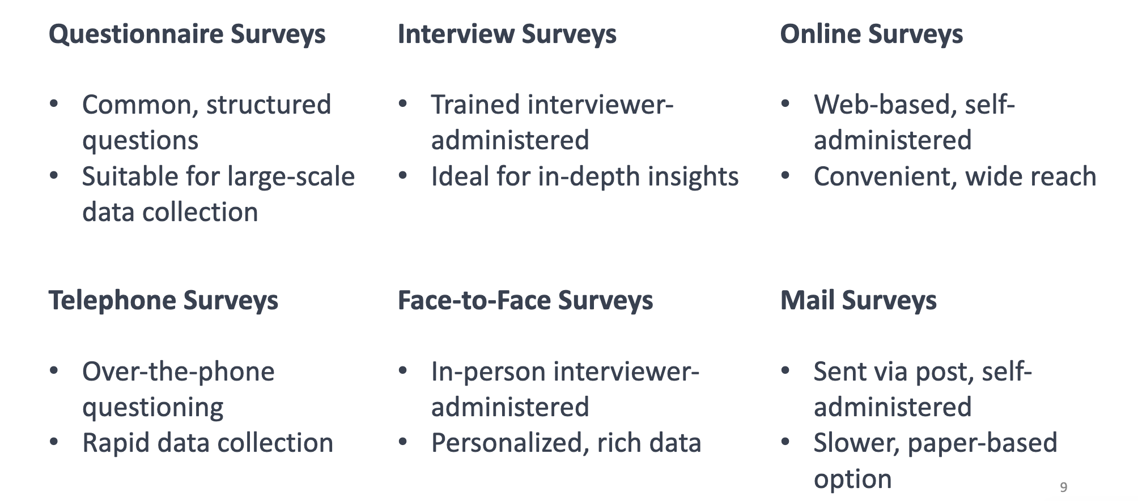
Survey Formats

Slide 7
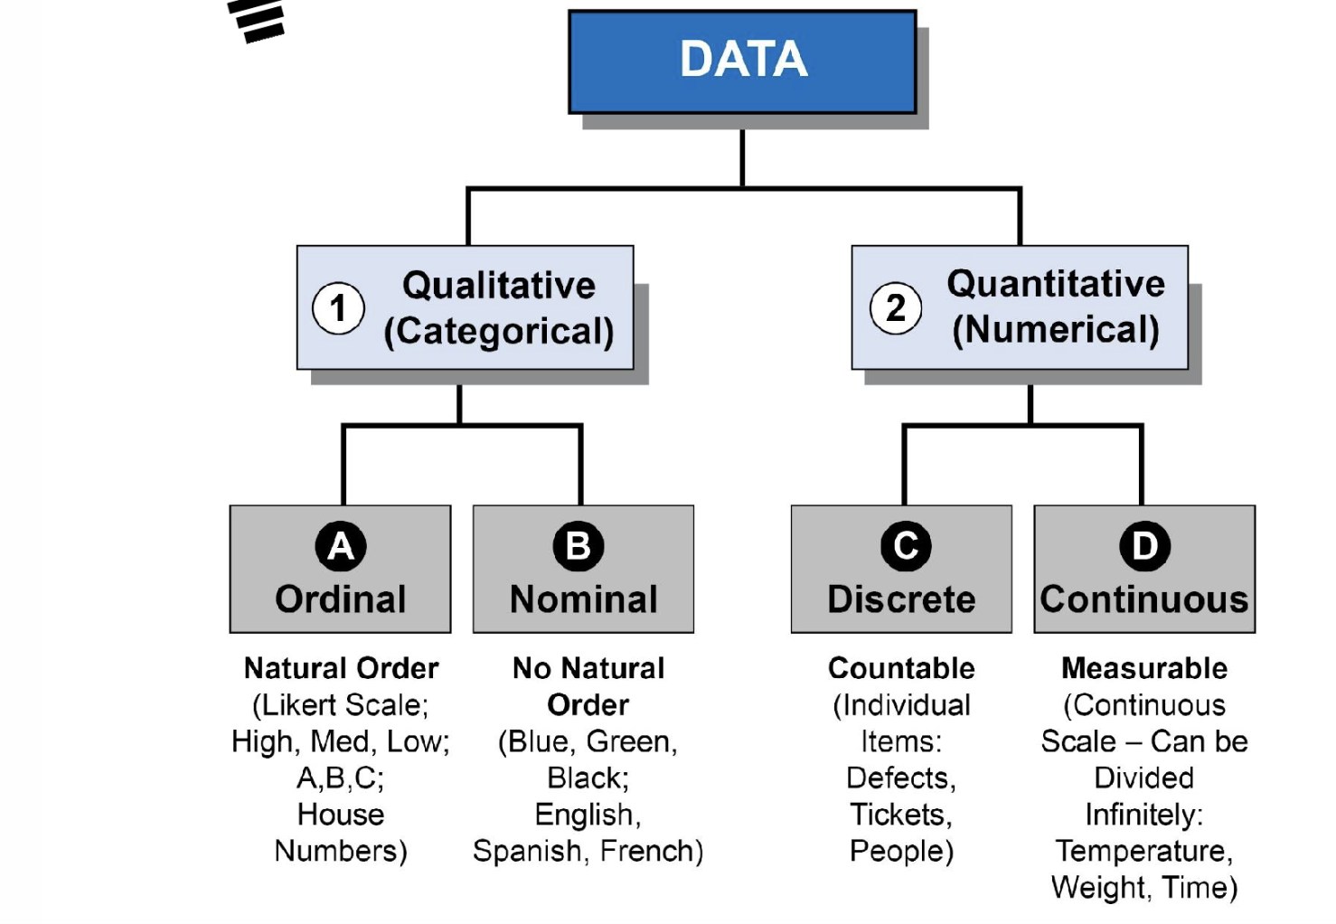
Recap

Slide 8
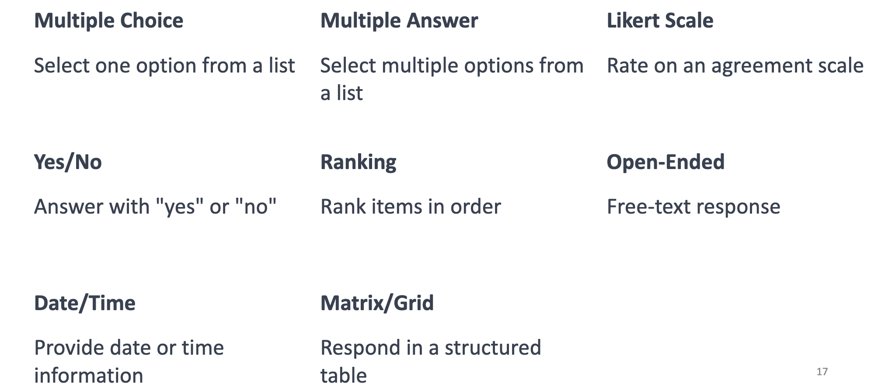
Survey Question Types

Slide 9
How to Ask Good Questions?

Slide 10
Example
❌ Bad
✅ Good
“Did you sleep a lot?” (Too vague. What is “a lot”?)
“How many hours did you sleep last night?” (Clear unit, numeric answer)

Slide 11
Example
❌ Bad
✅ Good
How did you feel today?
Rate your mood from 1 (very low) to 5 (very high)

Slide 12
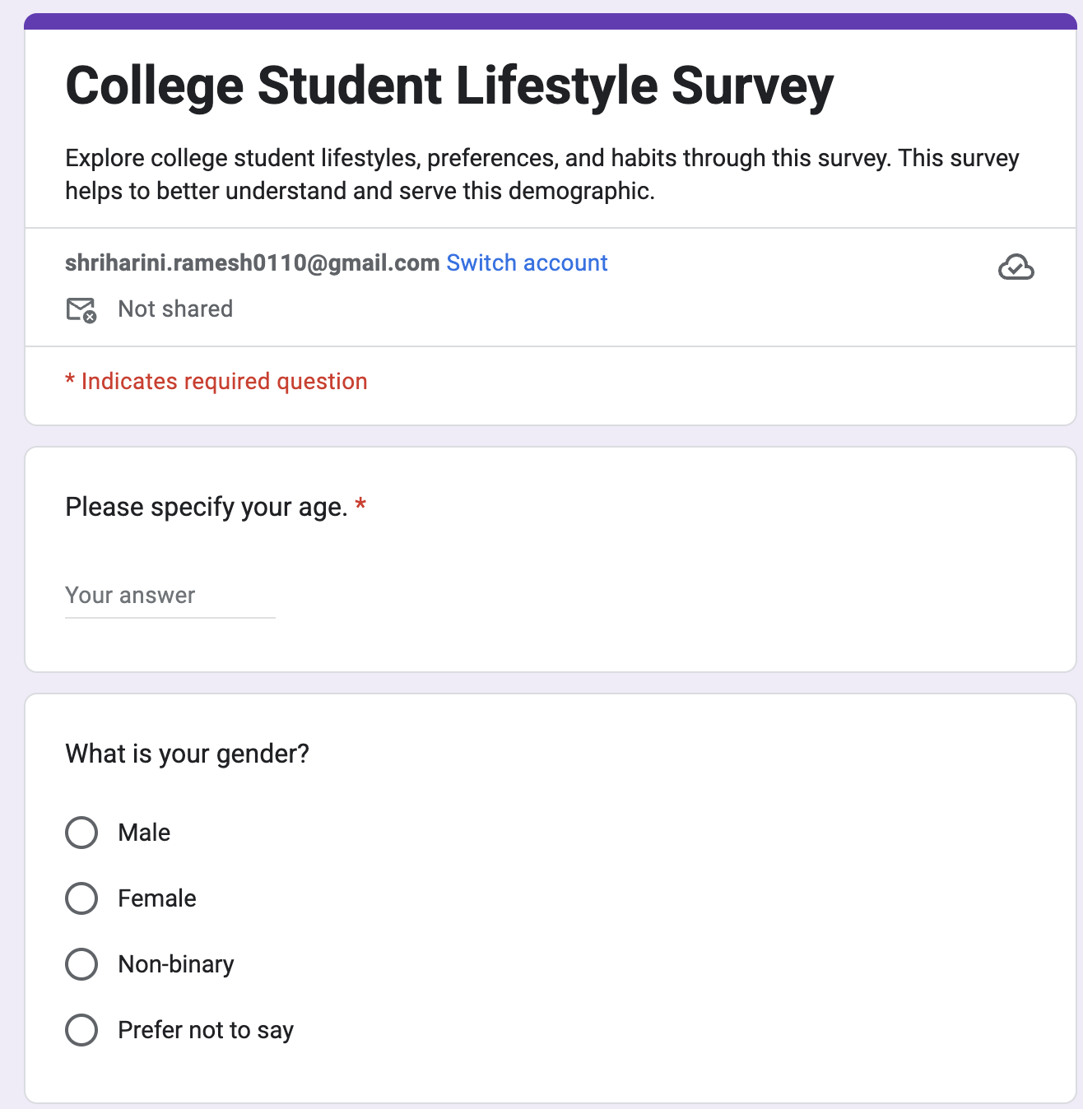
Survey Example
You can see the questionnaire survey example in the form below
https://forms.gle/QWFnzUcB2nqZZzuM8

Slide 14
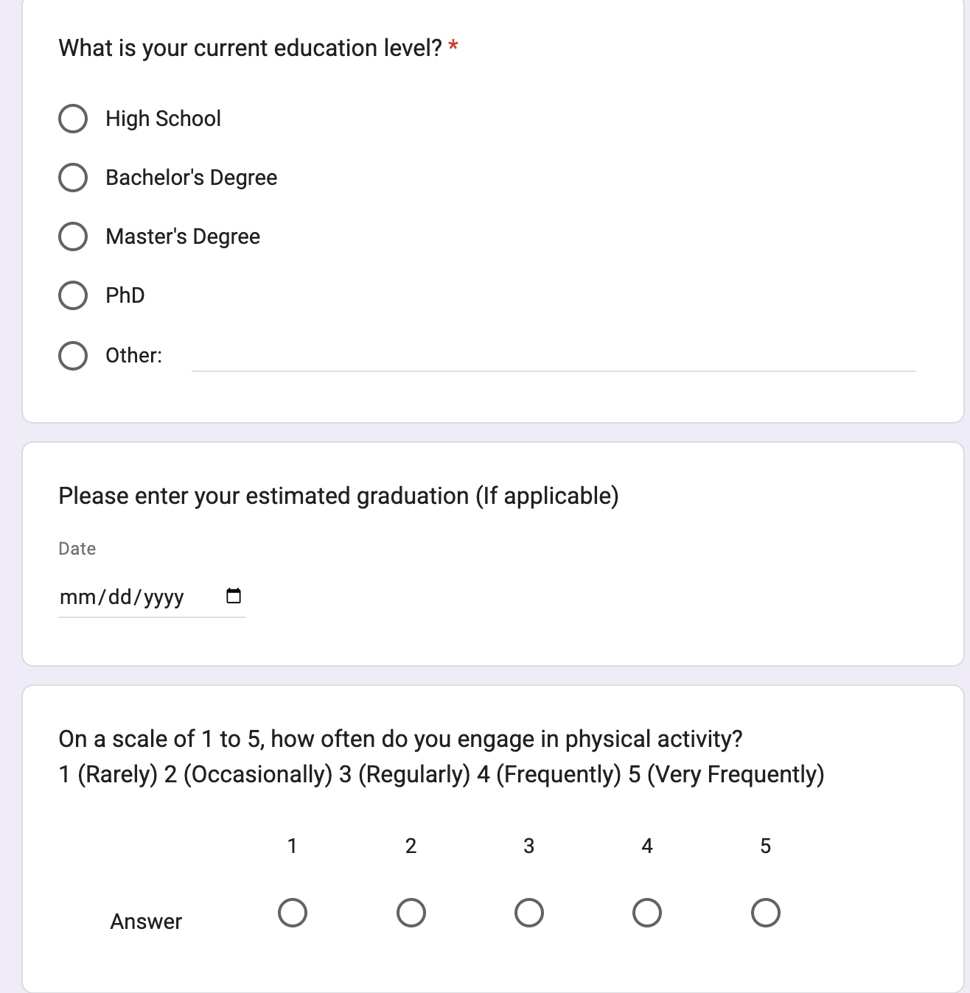

Slide 15
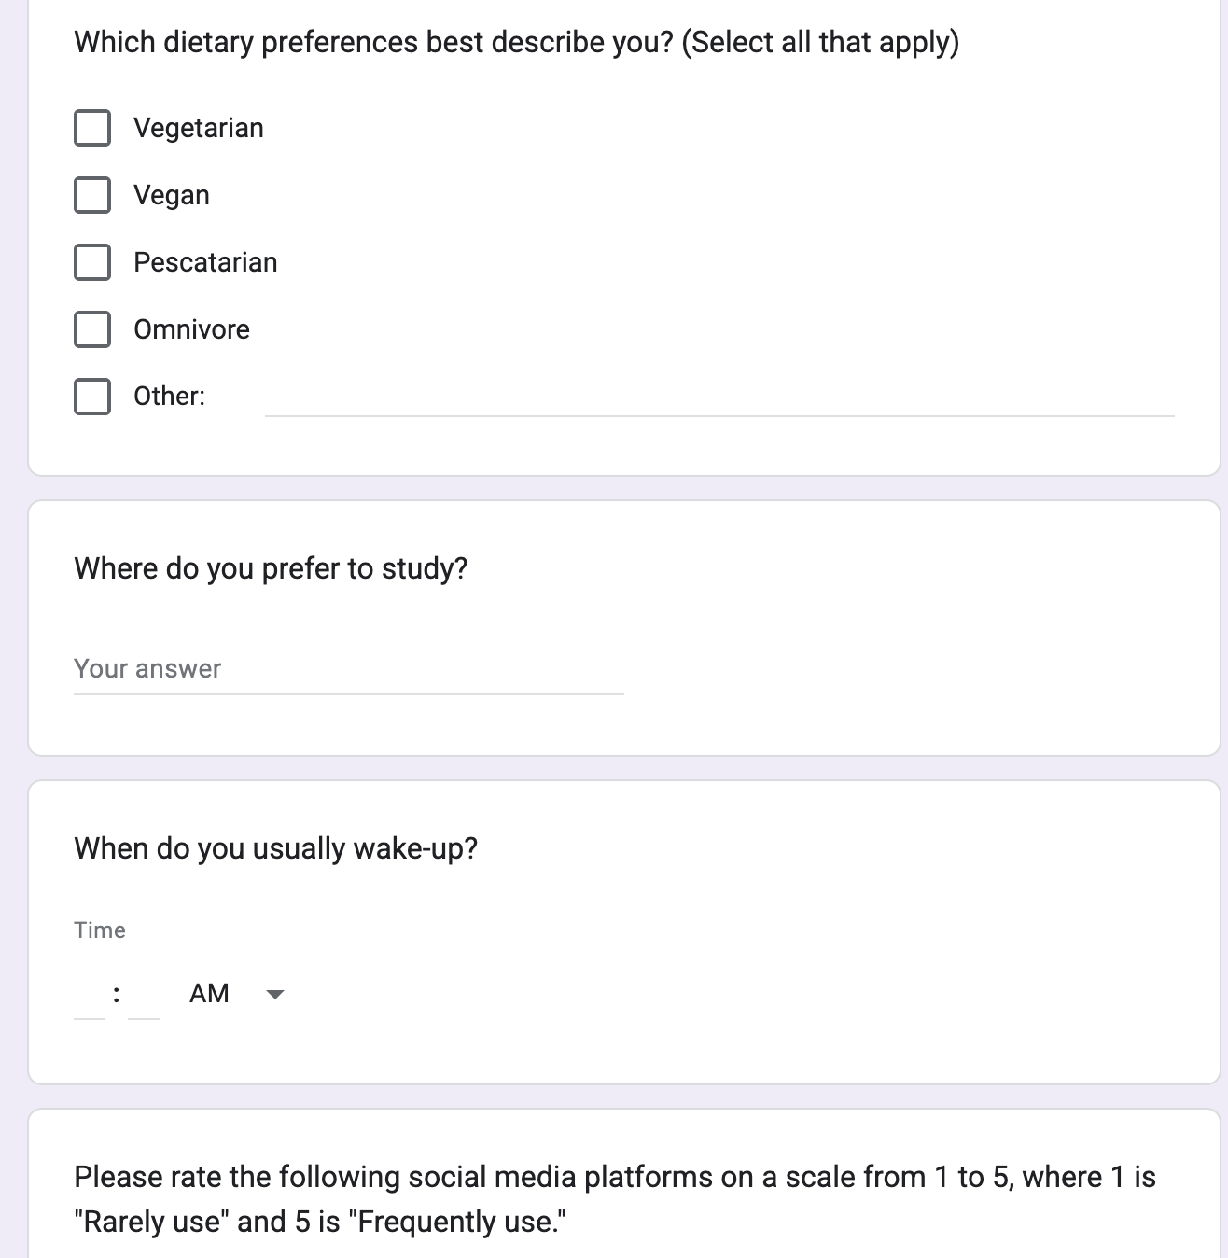

Slide 16
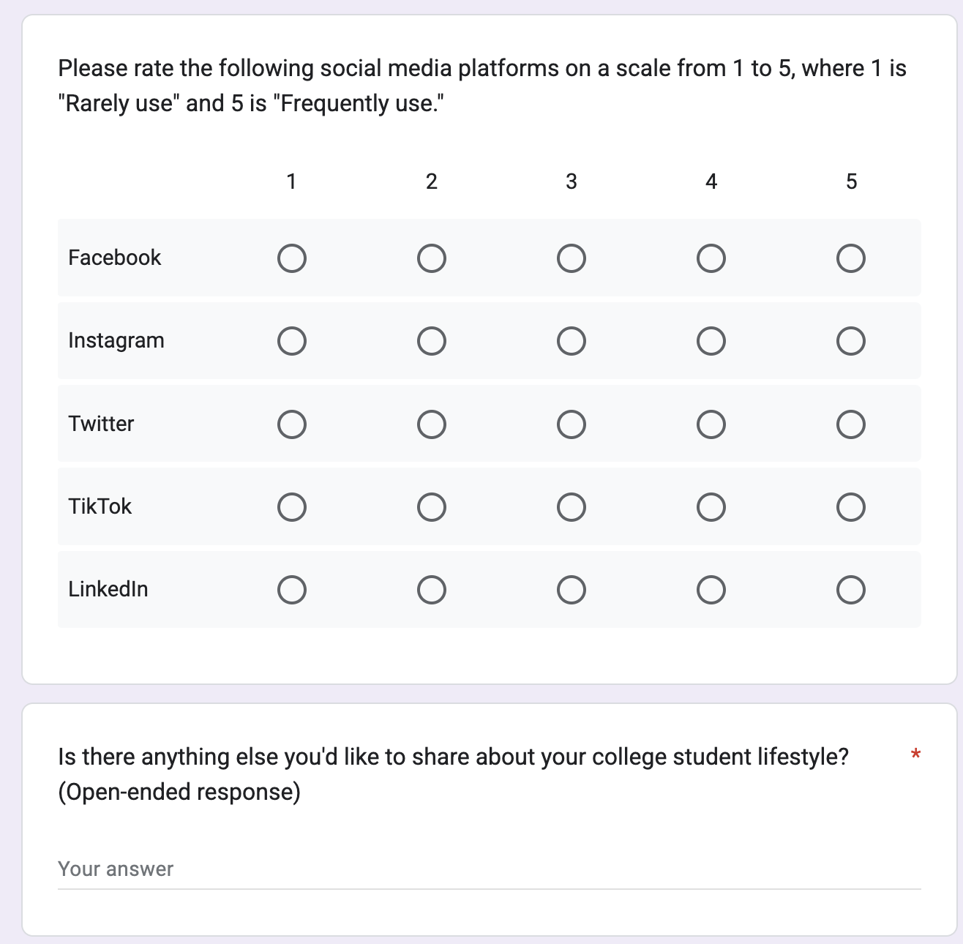

Slide 17
Data Cleaning

Slide 18
What is “Messy” Data?
name | Mood | Sleep hrs | breakfast | steps
Sam | Happy | 7.5 | Toast | 5000
christine | HAPPY | 07:30 | toast | 5k
JOSEPH | 🙂 | 7.5hrs | - | fiveK
 | sad | NA | cereal | 4500

Slide 19



What is “Messy” Data?
Text in numeric columns
Inconsistent entries
Typos/Capitalization issues
name | Mood | Sleep hrs | breakfast | steps
Sam | Happy | 7.5 | Toast | 5000
christine | HAPPY | 07:30 | toast | 5k
JOSEPH | 🙂 | 7.5hrs | - | fiveK
 | sad | NA | cereal | 4500
Emojis vs words
Missing Values

Slide 20
Let’s Clean This
Text in numeric columns
Inconsistent entries
Typos/Capitalization issues
name | Mood | Sleep hrs | breakfast | steps
Sam | Happy | 7.5 | Toast | 5000
christine | HAPPY | 07:30 | toast | 5k
JOSEPH | 🙂 | 7.5hrs | - | fiveK
 | sad | NA | cereal | 4500
Emojis vs words
Missing Values

Slide 21
Let’s Clean a Dataset Together!

Slide 22
Sketches

Slide 23
Different Types of Charts?

Slide 24
https://datavizcatalogue.com/

Slide 25
Foundational Four

Slide 26
Tables and single values

Slide 27
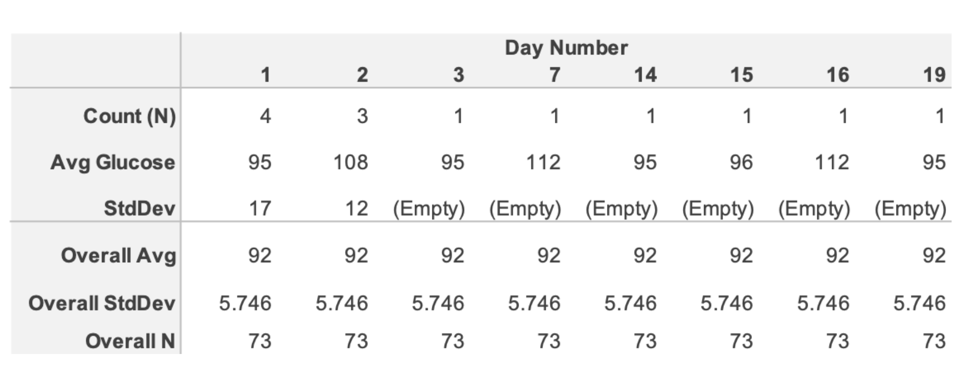
Raw Data

Slide 28
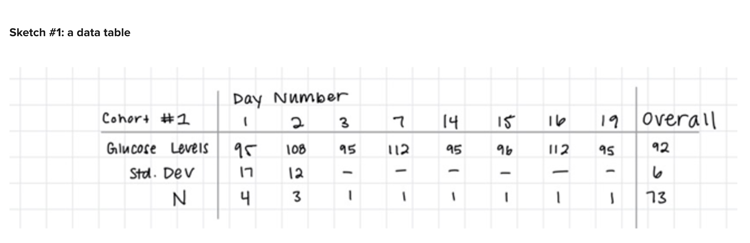
#1

Slide 29
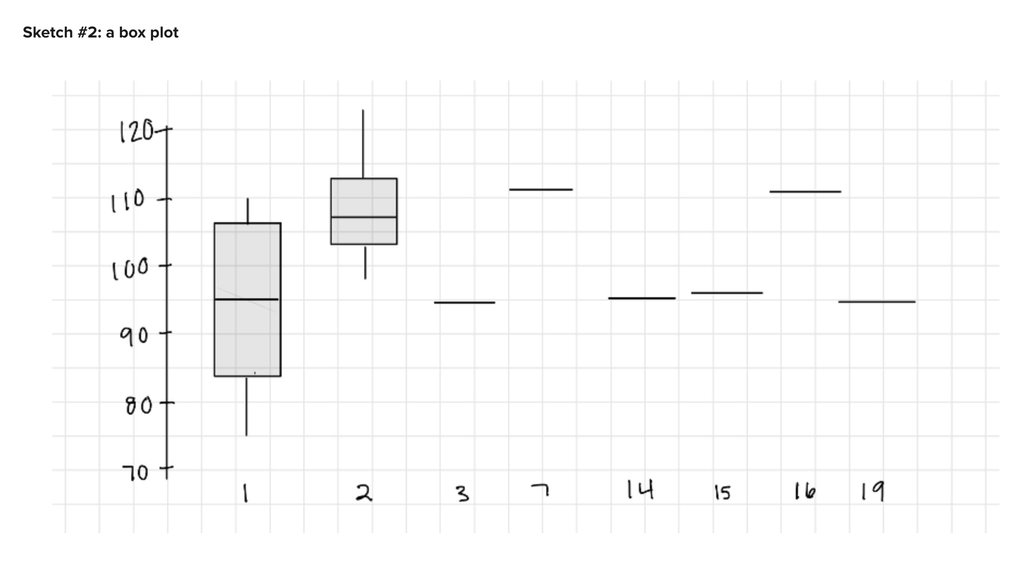
#2

Slide 30
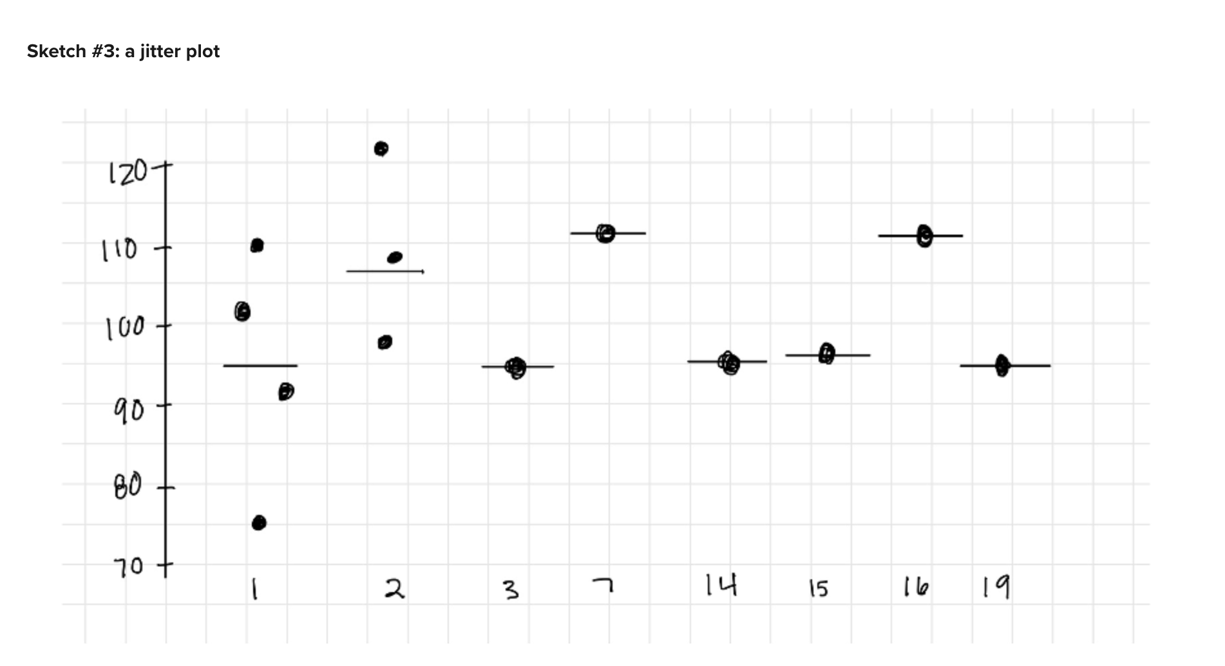
#3

Slide 31
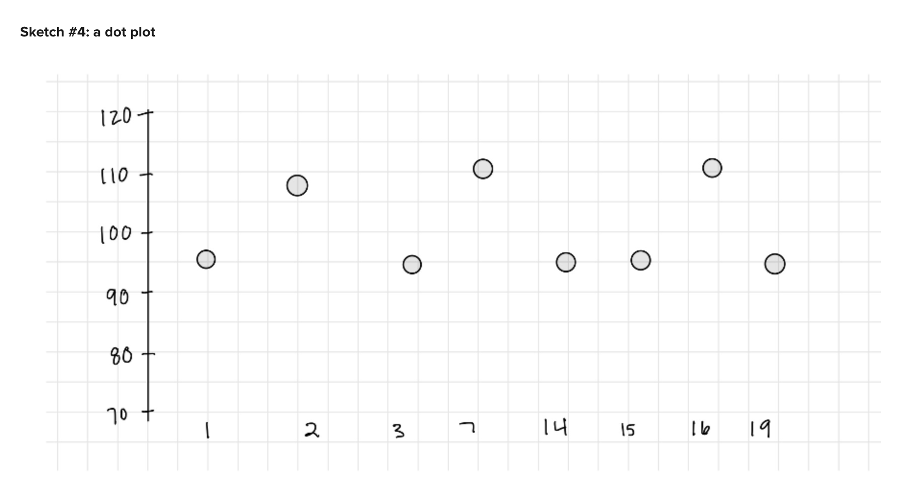
#4

Slide 32
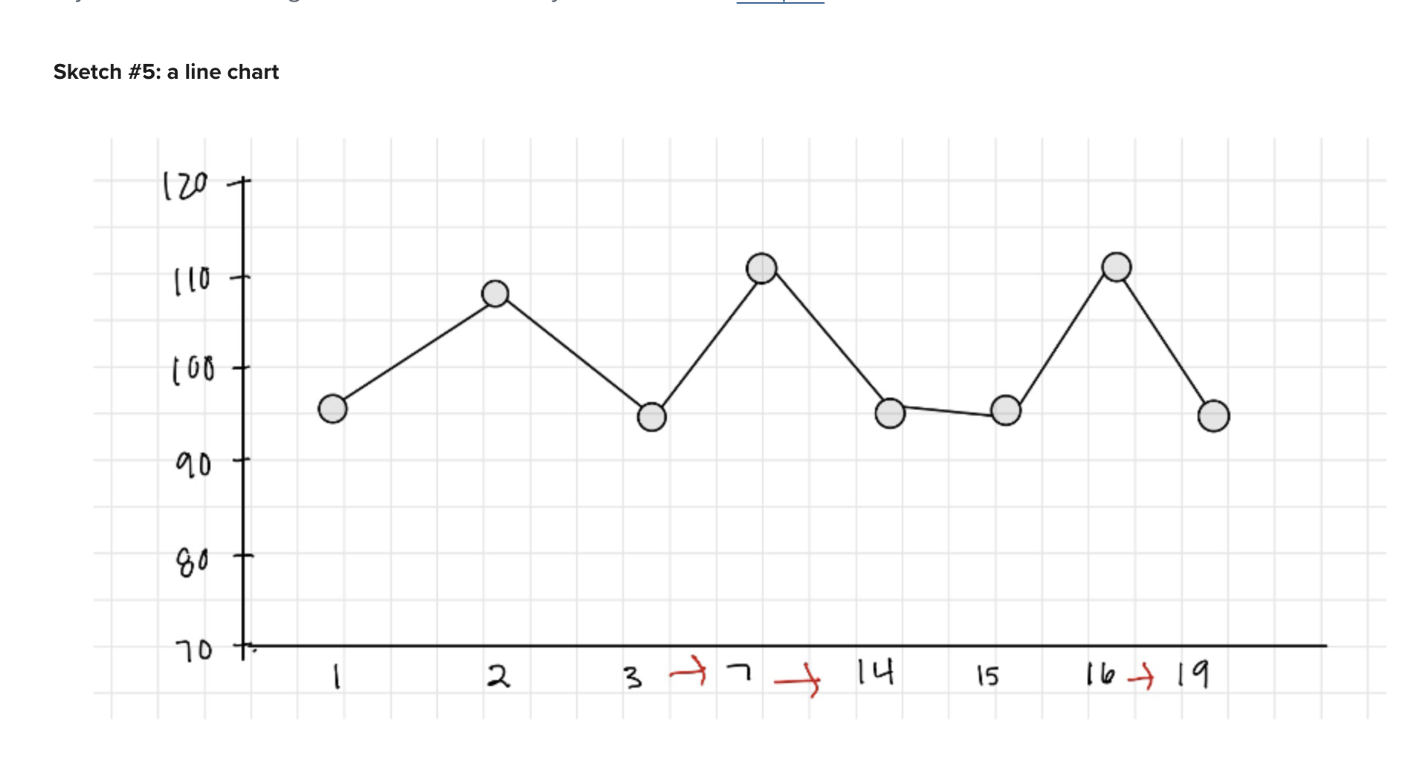
#5

Slide 33
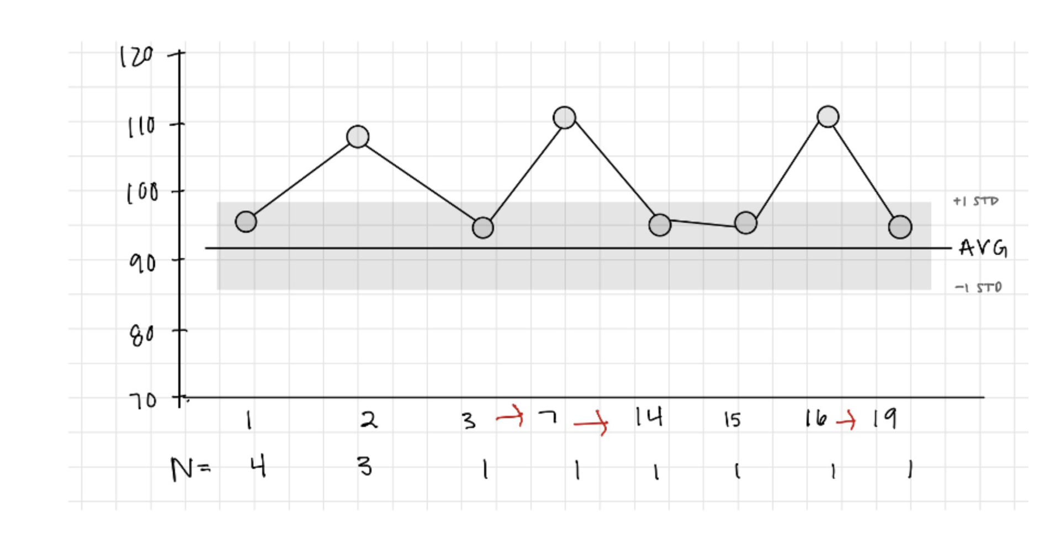
#6

Slide 34
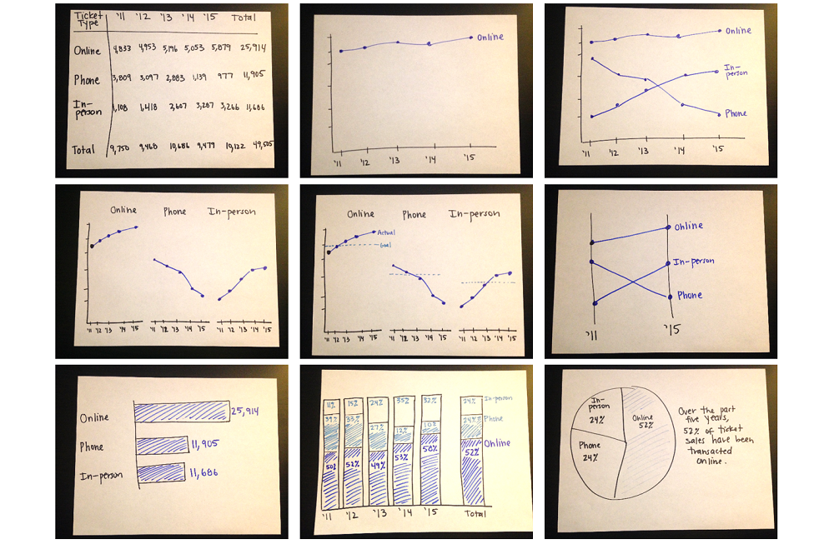
Examples

